Slide 1
Group 1
Bouhadan Imad, Dellafaille Lander, Mariën Levi, Pepermans Manu, Van de Mieroop Kevin

Slide 2

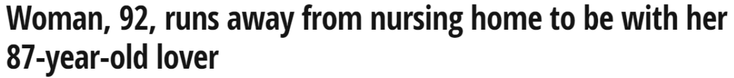

Introduction
Eldertrack
What is ElderTrack?
What can ElderTrack do for you?
Is ElderTrack worth buying?

Slide 3
Buildup of the project
Outdoor
LoRaWAN
data
Back-end
DASH7
RSSI + DATA
Indoor
e-Compass
Parsing
Barometer
GPS
ThingsBoard.io
Temperatuur
Fingerprinting

Slide 4
Backend
Parsing
Lander

Slide 5
Backend
Thingsboard.IO
Lander

Slide 6
Fingerprinting
KNN-Algorithm & Database
Lander/Imad

Slide 7
Frontend
Back-end
Frontend
Parsing
Temperature
DASH7 (Data + RSSI)
Barometer
ThingsBoard.io
FSM
GPS
Fingerprinting
LoRaWAN (DATA)
e-Compass

Slide 8
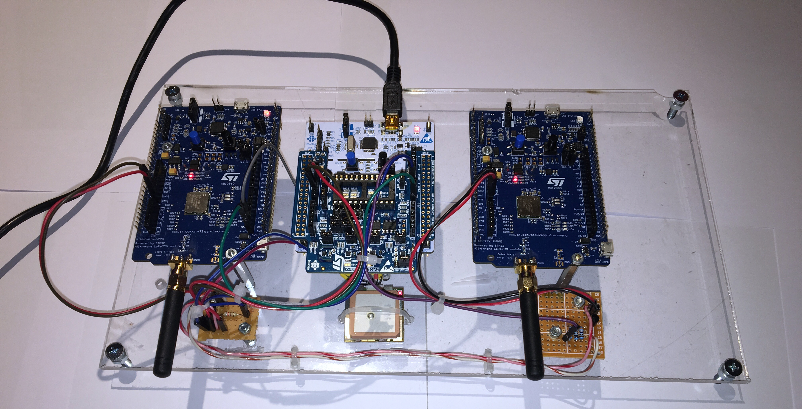
HARDWARE

Slide 9
Communication (OUTDOORs)
LoRAWAN
B-L072Z-LRWAN1
GPS Data to gateway
AT Commands
AT+JOIN
AT+SEND when data comes in
States
in_danger_zone
lora_ready
alarm_state
lora_sending

Slide 10
GPS (OUTDOORS)
NMEA commands
GPGLL : Latitude, N/S, Longtitude, E/W, Time, Data valid
Initializing
Hot Start
AT+SEND:2=“5117.1421,N,0000428.4897,E,230746.000,A,A*56”

Slide 11
Communication (INDOOR )
DASH7
Uplink: Sensordata + RSSI
Downlink: Alarm when outside
ALP Command

Slide 12
SENSOR (INDOOR)
Barometer & temperature
Imad

Slide 13
Control Unit
Finite State Machine (FSM)
DIAGRAM

Slide 14
SENSOR Outdoor
Ecompass
Levi

Slide 15
Implementation
Drivers
Levi

Slide 16
Documentation
Levi

Slide 17
Energy consumption
Low power features
Levi

Slide 18
Energy consumption
Estimation by CubeMX
Levi

Slide 19
Energy Consumption
Measured Energy consumption
Levi

Slide 20
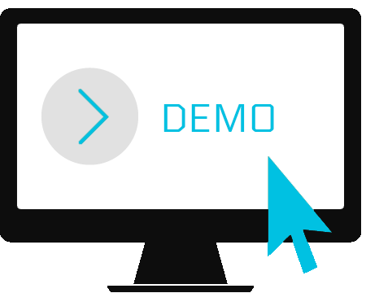
Demonstration

